Slide 1


CITS1003 Introduction to Cybersecurity [4] Introduction to Computers and Networks
Dr David Glance

Slide 2
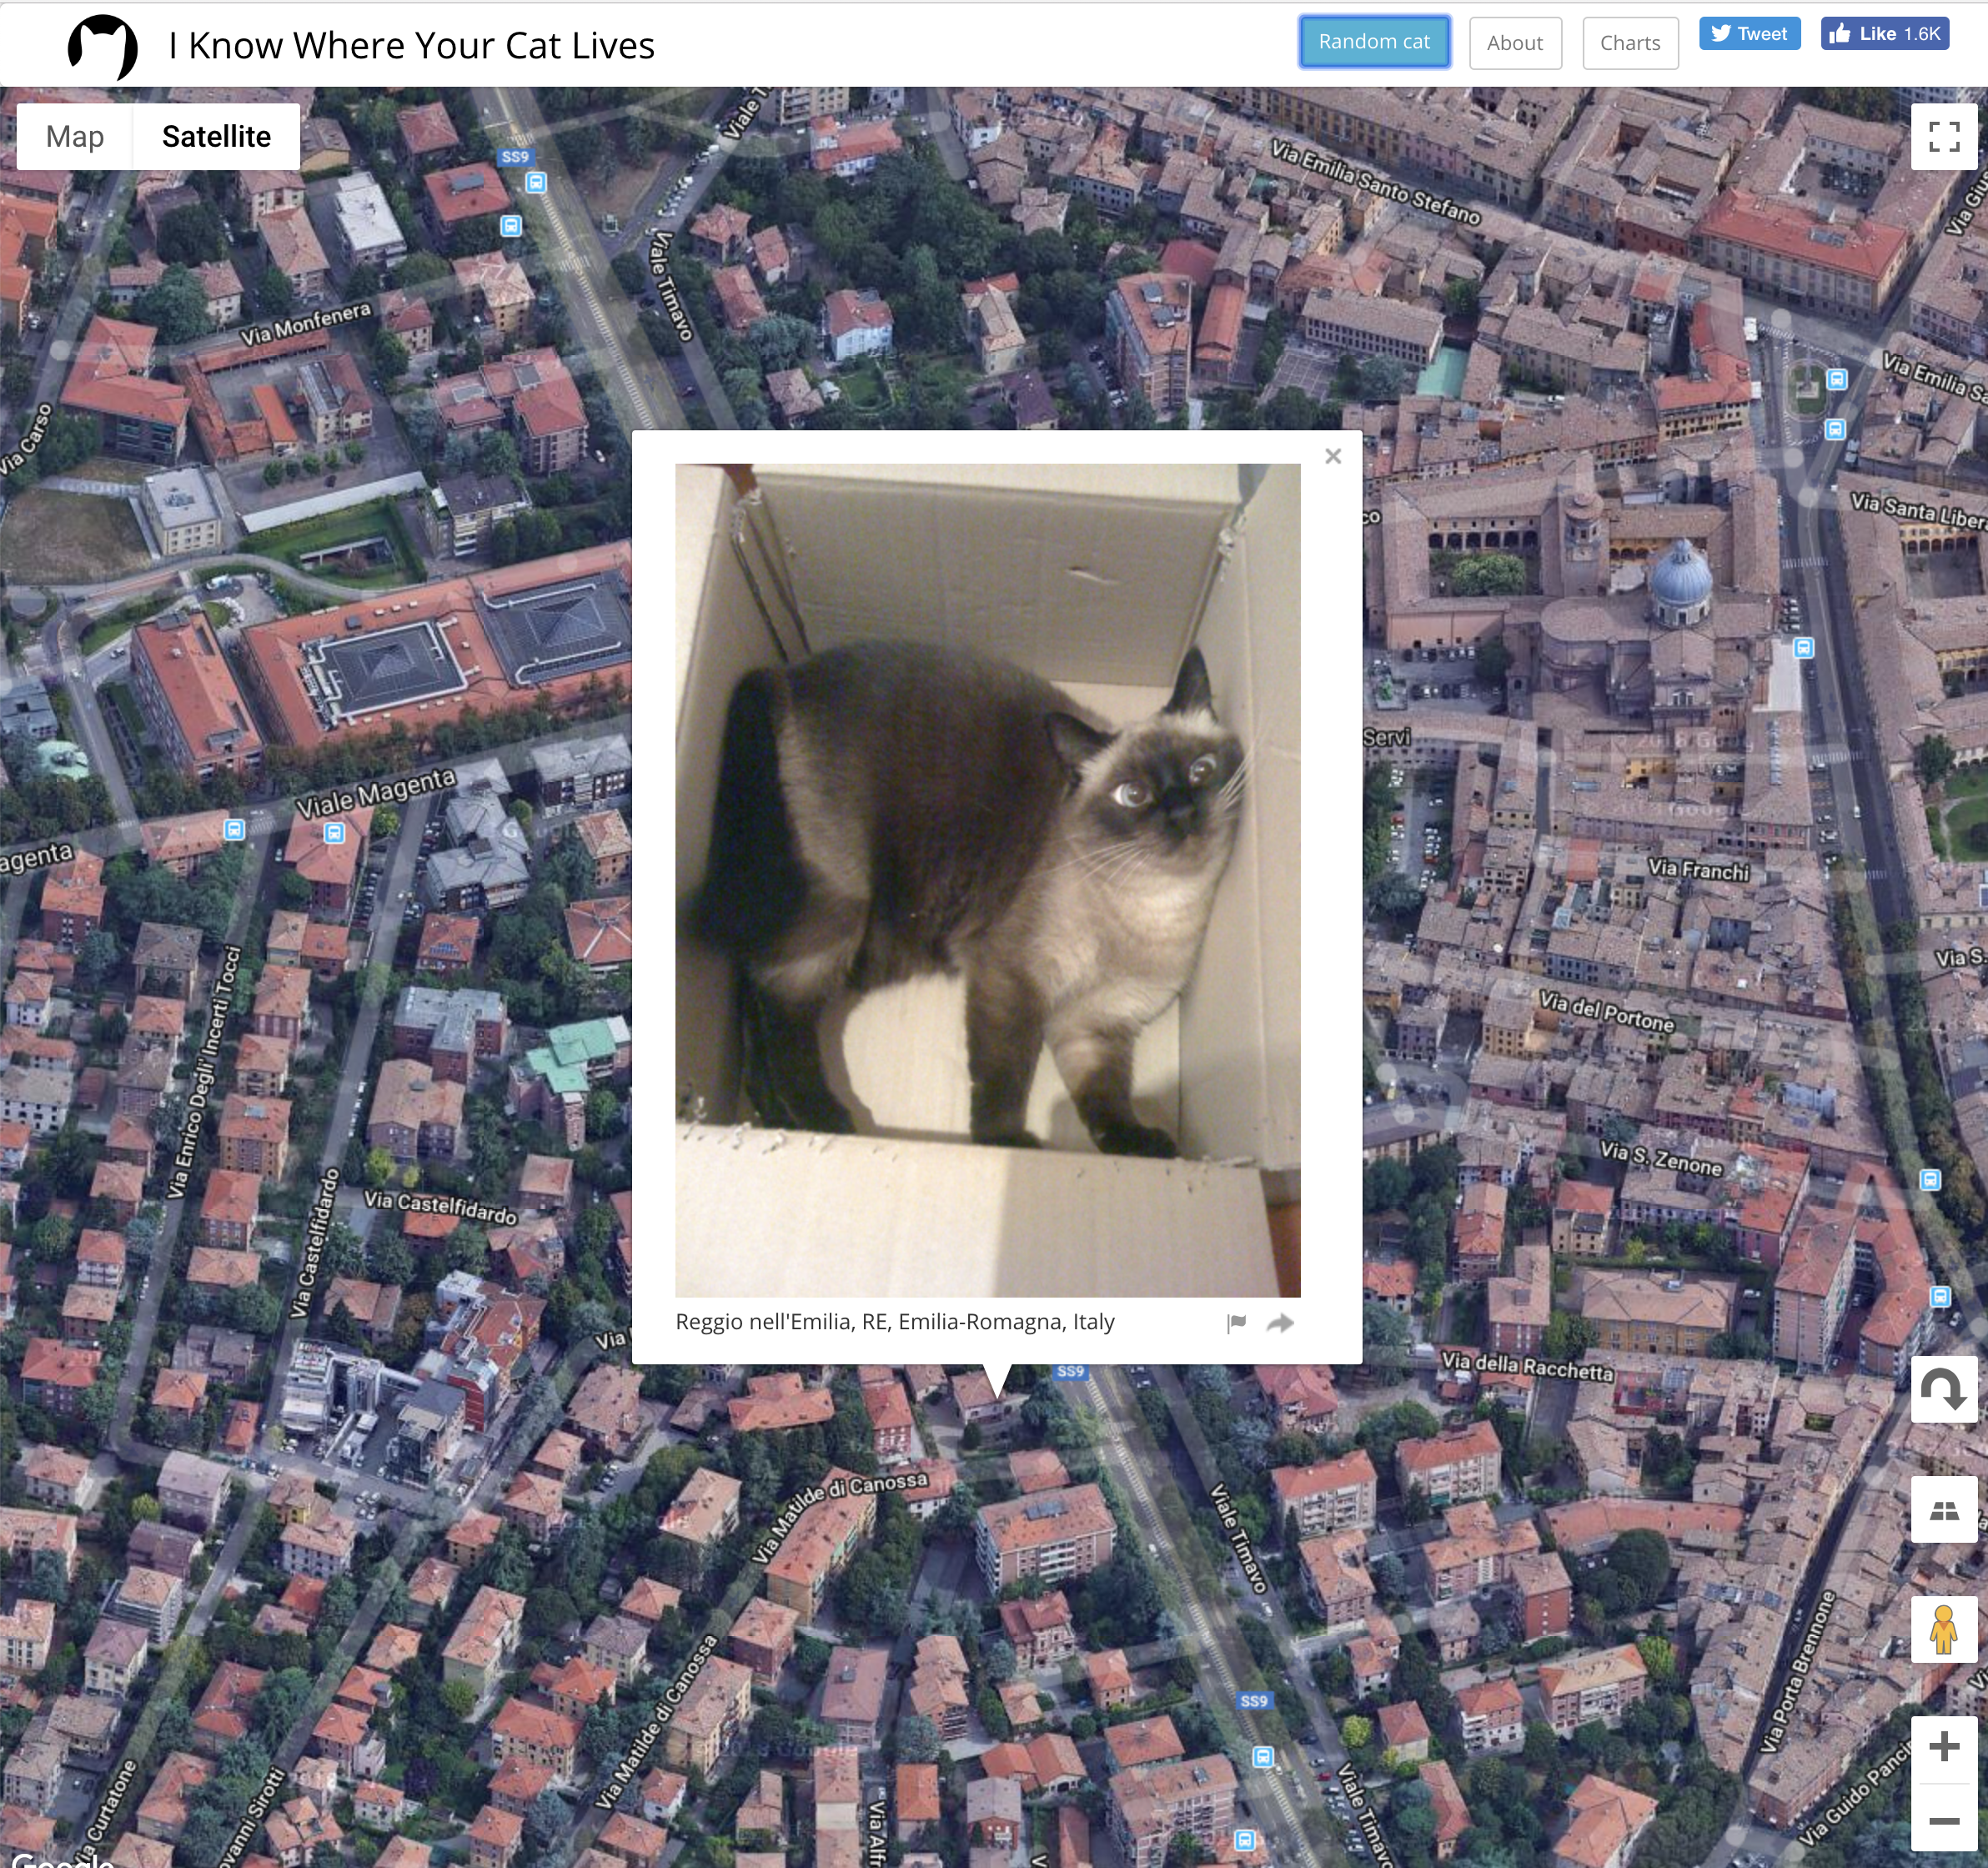
A unit about cats cybersecurity
I Know Where Your Cat Lives
https://iknowwhereyourcatlives.com/

Slide 3

Three things
Fundamentals and language of computer hardware and operating systems
How operating systems implement security
Fundamentals of networking and network security

Slide 4
Computers and Networks
Although we are focussed on general ideas around Cybersecurity, it is useful to at least have some understanding of computers and the networks they use to communicate over
We will look at PC architecture first in a generalised way and then the basics of how computer networks operate, especially TCP/IP, the network protocol of the Internet

Slide 5
PC Architecture
At one level of abstraction, a PC’s purpose is to run software applications
Applications are run by an Operating System: e.g. Windows, Linux MacOS
Before an Operating System can run, it needs to be loaded and started and this is the job of firmware or a “bootloader”. Firmware exists in devices like hard drives, network cards, sound cards, etc
This is all running on hardware: the components of the PC that store, execute and process inputs and outputs
Applications
Operating System
Firmware
Hardware

Slide 6
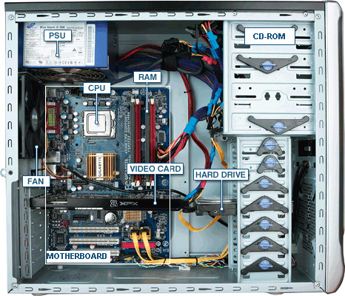
PC Hardware
CPU: Central processing unit
RAM: Random Access Memory
PSU: Power Supply Unit
Fan: Fan
Video Card
Hard Drive
Motherboard
Network card: Wired and/or Wireless (not shown)
http://tazalink.blogspot.com/

Slide 7
CPU
The CPU processes instructions and data that are stored in memory
Memory is either random access memory (RAM) or read only memory (ROM)
Instructions and data are transported between memory and the CPU over a Bus. Either:
Address Bus
Data Bus
Control Bus
The CPU can also read and write data from an Input/Output (I/O) device
Instructions that are processed by the CPU are simple operations like add, subtract, AND, OR, XOR, etc

Slide 8
Booting Up
When a computer is powered on, the firmware in ROM is loaded and run. This is the BIOS (Basic Input Output System).
The BIOS will run a Power-On Self Test (POST) to check for hardware components like a display, keyboard, network card, memory.
The BIOS will then load the first 512 bytes from the hard drive called the Master Boot Record (MBR) This contains the bootloader code that will execute and load the operating system

Slide 9
Operating System
The operating system is responsible for a number of different tasks
Running and scheduling applications to run and share resources such as CPU, Disk, RAM
Allows for memory virtualization
Controlling access to I/O devices through I/O Driver software
Manage access control and authentication
Handle communication via networks
Handles graphical user interfaces

Slide 10
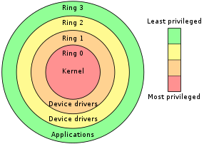
Kernel
The CPU operates in different modes: user mode and supervisor mode
Applications are run in different protective rings organised from the most secure and privileged in Ring 0 to application level code in Ring 4
Applications that are scheduled to run are prioritised depending on which ring they run in: Most privileged applications have priority
Organising the kernel in Ring 0 is a protection mechanism to allow only trusted code to run there

Slide 11
File Systems
A file:
Is a named collection of information stored on a storage device such as a internal disk drive or external USB drive
Has metadata such as name, type, location, size, protection, creator, creation time, etc
Has an owner and permissions for access control
Organised in directories or folders
Operating system supports a file system which is a way of organising files on a disk, providing operations of creating, reading, writing and deleting files
Devices can be logically viewed as files as well
Numerous file system types: FAT, NTFS, APFS, EXT etc
Access is controlled by discretionary and role based access control

Slide 12
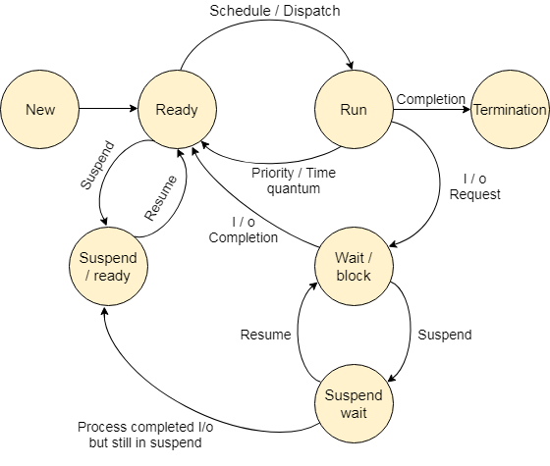
Processes
The operating system is responsible for running programs and managing their access to system resources
When a program is running it is known as a process and multiple processes may be running at the same time
The process may be in a number of different states depending on what actions it is performing or whether it has used up its time quantum

Slide 13
Process States
State | Description
Start | This is the initial state when a process is first started/created.
Ready | The process is waiting to be assigned to a processor. Ready processes are waiting to have the processor allocated to them by the operating system so that they can run. Process may come into this state after Start state or while running it by but interrupted by the scheduler to assign CPU to some other process.
Running | Once the process has been assigned to a processor by the OS scheduler, the process state is set to running and the processor executes its instructions.
Waiting | Process moves into the waiting state if it needs to wait for a resource, such as waiting for user input, or waiting for a file to become available.
Exit | Once the process finishes its execution, or it is terminated by the operating system, it is moved to the terminated state where it waits to be removed from main memory.
Processes are scheduled by the operating system according to one of a number of different algorithms
Processes may run at the same time if the computer has multiple processors
Simultaneous execution can happen through multithreading
A lightweight version of a process

Slide 14
Process Attributes
Process ID (pid): A process is uniquely identified by a numeric identifier
Parent: All processes are started by another process and so maintains links to their parent and may inherit attributes such as open files and access to terminals
Parent processes are identified by the Process Parent ID (ppid)
Files: Processes work on files (and devices that are represented as files) and so information about these are kept for each process
Virtual Memory: A process is allocated memory to store the code and data that it operates on. If this becomes too large for physical memory, it may be mapped to disk

Slide 15
Access Control
Access control restricts who has access to an object (e.g. file) and what operations they may perform on it. Different types:
Discretionary Access Control (DAC)
Mandatory Access Control (MAC)
Role-Based Access Control (RBAC)
Rule-Based Access Control
Attribute Based Access Control

Slide 16
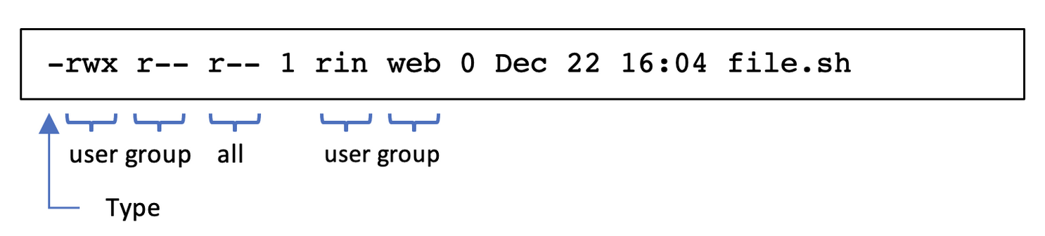
DAC and RBAC
Discretionary Access Control (DAC): Each object has an owner who grants access to other users
Linux and Windows file systems use this along with role based access control
Role-Based Access Control (RBAC): Access is granted by administrators to groups of users based on their roles
In Linux: operations are r (read), w (write), x (execute) and are set on each file and directory

Slide 17
Rules, ABAC and MAC
Rule-Based Access Control: Access is granted based on rules/policies
Firewalls use this type of access control
Cloud Services object storage also uses policies to grant access
Attribute Based Access Control (ABAC): Access granted based on attributes (device, location, time of day)
Networks such as WiFi that restrict access based on MAC address or time of day
”Allow access from mobile devices”
Mandatory Access Control (MAC): Access is granted based on labels assigned to the user and the object.
Used in situations were access is determined by security level e.g. Top Secret vs Secret

Slide 18
Networking
A network card is responsible for the interface with either a fixed network or with WiFi
Both run TCP/IP which is a layered protocol
Each layer adds information to a packet in order for it to travel over the medium
The Link layer deals with the physical network
Each Network Interface Card (NIC) is assigned a unique number to identify it known as the MAC (Media Access Control) address
f8:ff:c2:01:fa:e5

Slide 19
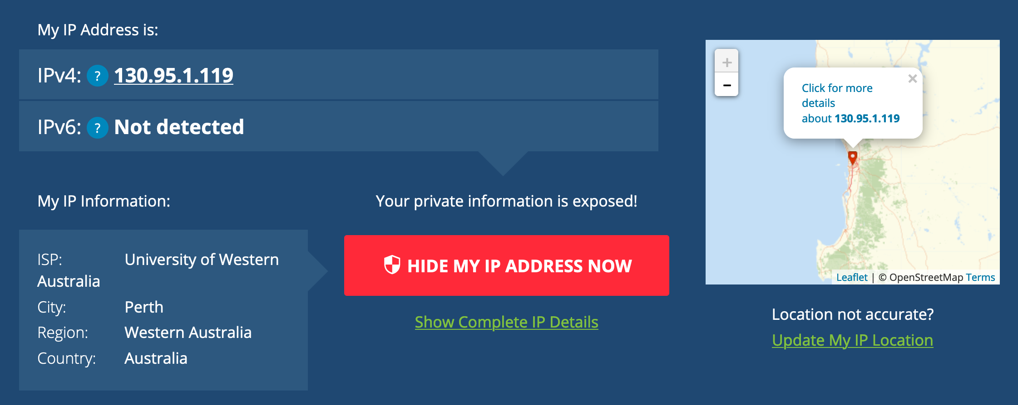
IP Addresses
In the Internet layer, TCP/IP uses IP addresses to identify the machine that is sending, and the machine that is going to receive the packet. The IP address is normally 4 numbers separated by full stops
130.95.1.119
To make it easier to find addresses, we can use a domain name
www.uwa.edu.au which translates to13.70.147.206
TCP/IP uses a Domain Name Server (DNS) as a directory to do the translation. The DNS is a service that internet service providers (ISPs) and organisations run to manage their own domain names
Technically, this is IP version 4. There is a newer version IP version 6 (IPv6) which uses a longer address format.

Slide 20
Network Addresses
An IP address is actually a combination of a network address and a host address.
Computers can directly communicate with each other on a subnetwork without going through a router.
A router connects subnetworks to other networks
Everything running in a home exists on a subnetwork that is connected to the Internet via a router (and a modem)
The network portion of the address is indicated by a notation as follows:
130.95.1.0/24
The last byte is the host address and so on this subnet, there can be 254 hosts that can be addressed on this subnet

Slide 21
Network Addresses
An IP address is actually a combination of a network address and a host address.
Computers can directly communicate with each other on a subnetwork without going through a router.
A router connects subnetworks to other networks
Everything running in a home exists on a subnetwork that is connected to the Internet via a router (and a modem)
The network portion of the address is indicated by a notation as follows:
130.95.1.0/24
The last byte is the host address and so on this subnet, there can be 254 hosts that can be addressed on this subnet

Slide 22
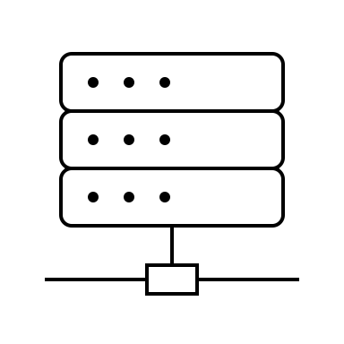

Application Ports
At the Application layer, TCP/IP decides which application to give a packet to based on an identifier called a port.
Ports are numbers between 0 and 65,536
A web server like the one on www.uwa.edu.au runs on port 443
Other applications may offer services on different ports (e.g. File Sharing)
443 → www.uwa.edu.au
https://www.uwa.edu.au:443

Slide 23

Routers
A router is a device that handles forwarding packets to their next destination
TCP/IP packets hop from network to network to get to a particular destination determined by routing tables
Within an organisation may have routers and switches handling multiple subnets
https://geotraceroute.com

Slide 24



Firewalls
Firewalls are network devices that apply a set of rules to incoming and outgoing network traffic.
The rules are based on IP addresses and ports
Firewalls can be used to create secure zones that partition communications from different sets of users
For example, Staff and students can access the intranet website
Outsiders can access the main UWA website
We can control access using routers and firewalls that blocks access to internal sites
intranet.uwa.edu.au
www.uwa.edu.au

Slide 25
HTTP
HTTP Hypertext Transfer Protocol is the communication protocol used to access resources like web pages, images and media files from a web server
It operates at the Application layer of TCP/IP
It operates using URLs (Uniform Resource Locators) to refer to specific resources that it wants to web server to take action on – like fetching it for display in a browser
HTTP is unencrypted and so is not confidential

Slide 26
HTTPS/TLS
HTTPS is a secure version of HTTP (hence the S) that initially used SSL (Secure Socket Layer) although this became TLS for Transport Layer Security
HTTPS is still referred to as SSL
Current version of TLS is 1.3 although 1.2 is still prevalent
TLS makes use of certificates that have the verified identity of the server and the server’s public key
The certificate is verified by a trusted certificate authority. Browsers maintain a list of these that gets updated from time to time

Slide 27
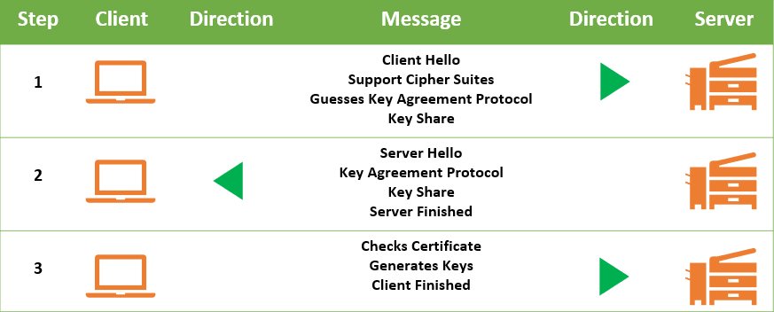
TLS 1.3
TLS establishes a connection by exchanging messages to:
Agree the cipher that will be used
Which key exchange protocol to use
Create and share keys
Check server and client identity through certificates
https://cheapsslsecurity.com/blog/tls-1-3-everything-you-need-to-know/

Slide 28
VPN
Virtual Private Network (VPN) software allows a computer on one network to create a direct connection to another network over a secure link
Effectively you get an IP address on the network you have connected to
VPNs can run over a number of different protocols: e.g. IPSec, OpenVPN, IKEv2 and WireGuard
Communications are encrypted and so not visible to anyone inspecting traffic - even to the ISP you are using
Connecting to a network in a different country will make it appear that the computer is in that country
Location can leak from other sources such as the browser
VPNs provide security through encrypted communication and privacy through the VPN provider not keeping logs
VPNs do not provide anonymity

Slide 29
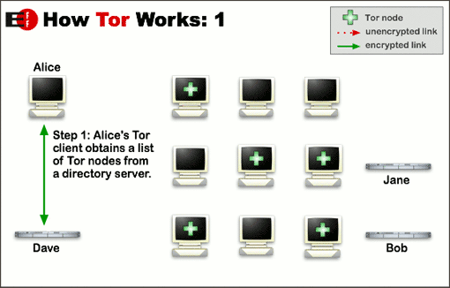
Tor and The Dark Web
Tor (The onion routing project) is software that provides IP anonymity by bouncing encrypted packets over a set of Tor servers called relays or nodes.
The Tor client obtains a set of nodes from a directory server

Slide 30
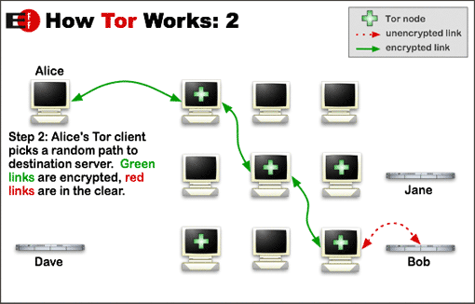
How Tor Works 2
The Tor client decides on a random path through the nodes and encrypts the message with each nodes key
This is the analogy with the onion layers

Slide 31
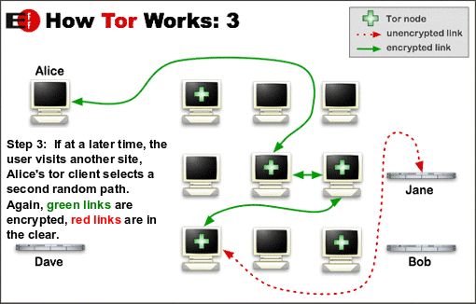
How Tor Works 3
Each subsequent site chooses a new path
The server only has a return address of a the exit node

Slide 32
Tor Onion (Hidden) Services
Tor uses an address called an onion address to connect to services offered on the Tor network
These addresses are like URLs
The Dark Web is essentially the collection of onion services that are not indexed directly by search engines on the “regular” web
Because of the anonymity provided by Tor and the semi-hidden nature of onion services, many illegal activities have flourished with Dark Markets selling illegal products that are paid for using cryptocurrencies
The anonymity provided by Tor is also of more positive use by activists and those simply wanting to browse the web anonymously

